Slide 1

Operating systems
Barizs Márton Dániel
Beke Tamás
11.B

Slide 2

The operating system
There are several types of definitions:
I.
The operating system is a collection of programs that makes your computer hardware versatile, easy- and safe to use. It also provides a single interface for both the programs and the user. The operating system is often abbreviated as "OS" from the English word "operation system".
II.
The operating system is the software part of a computer, a program system that loads and controls the programs (applications) running on the computer, allocates and schedules resources, manages hardware, and provides communication between the user and the computer system.
Hello, I’m Mowgly,
I will tell you these things! ☺

Slide 3
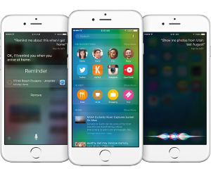
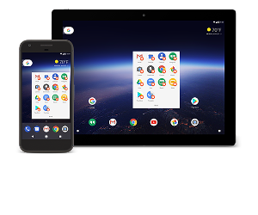
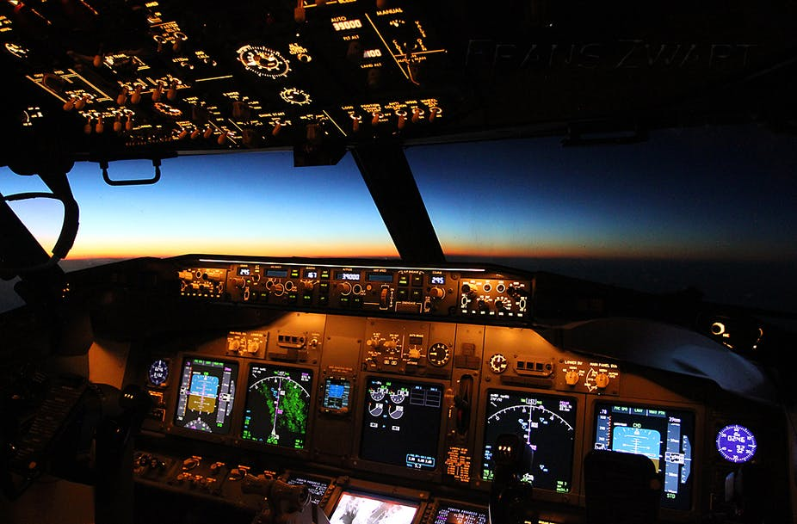
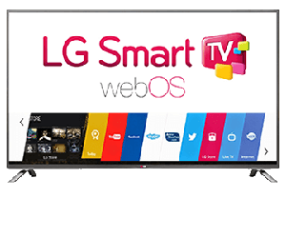
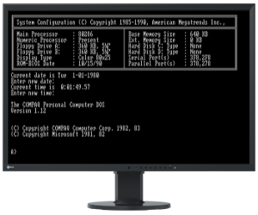
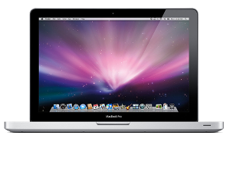
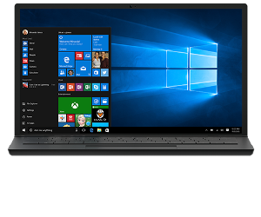
The operating system
There are many operating systems.
Operating systems are not only found in personal computers, but also in smartphones, smart TVs, cars, airplanes... etc.

Slide 4
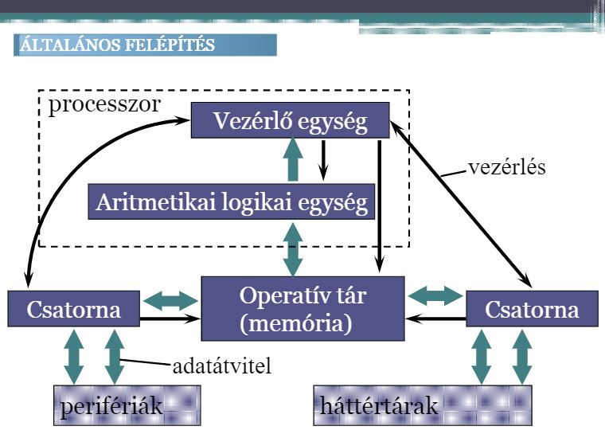
The operating system -Tasks
Handling and operating the hardware of the machine
Running applications
Scheduling processing, sharing resources
Managing and transferring data
Securely storing programs and data
Reporting and handling malfunctions
Managing networks
The basic structure of a computer:

Slide 5
Operating system’s tasks
Tools and tasks of operating systems:
Device Drivers
Single user interface for different peripherals
Interrupt Handling
System Call, Reply
servicing the resource requirements of user applications (running and organising programs)
Resource Management
prevention of asset sharing or conflict
resolving conflicts
CPU Scheduling
- allocate processor time between queued jobs based on some strategy
- switching between jobs
Memory Management
allocating memory space between jobs
File and Disk Management
organisation, record keeping
User Interface
ensure communication with the user
Net Management

Slide 6
Mostly known / Newest operating systems

Slide 7
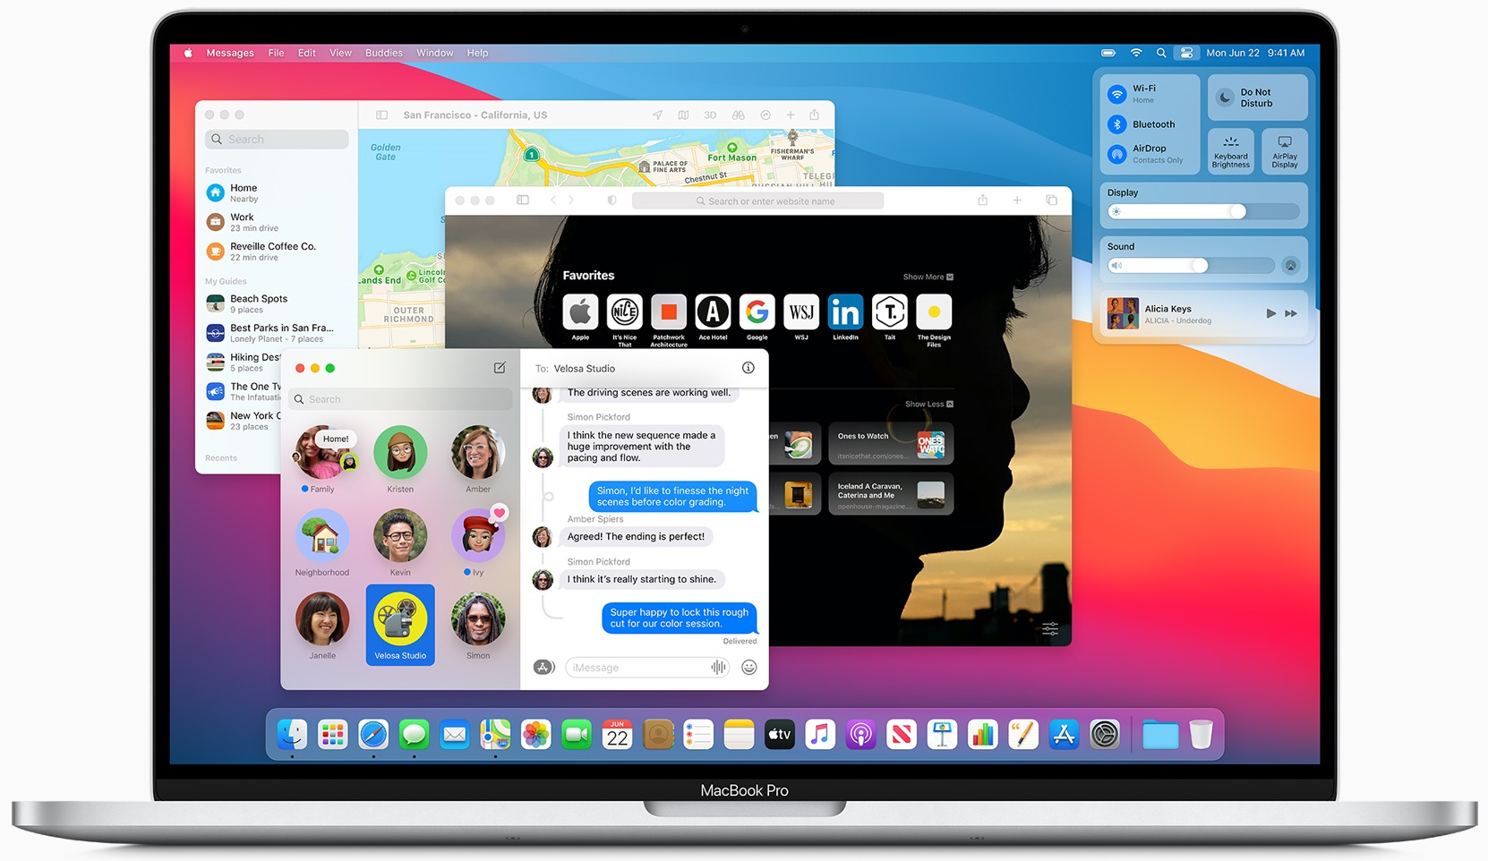
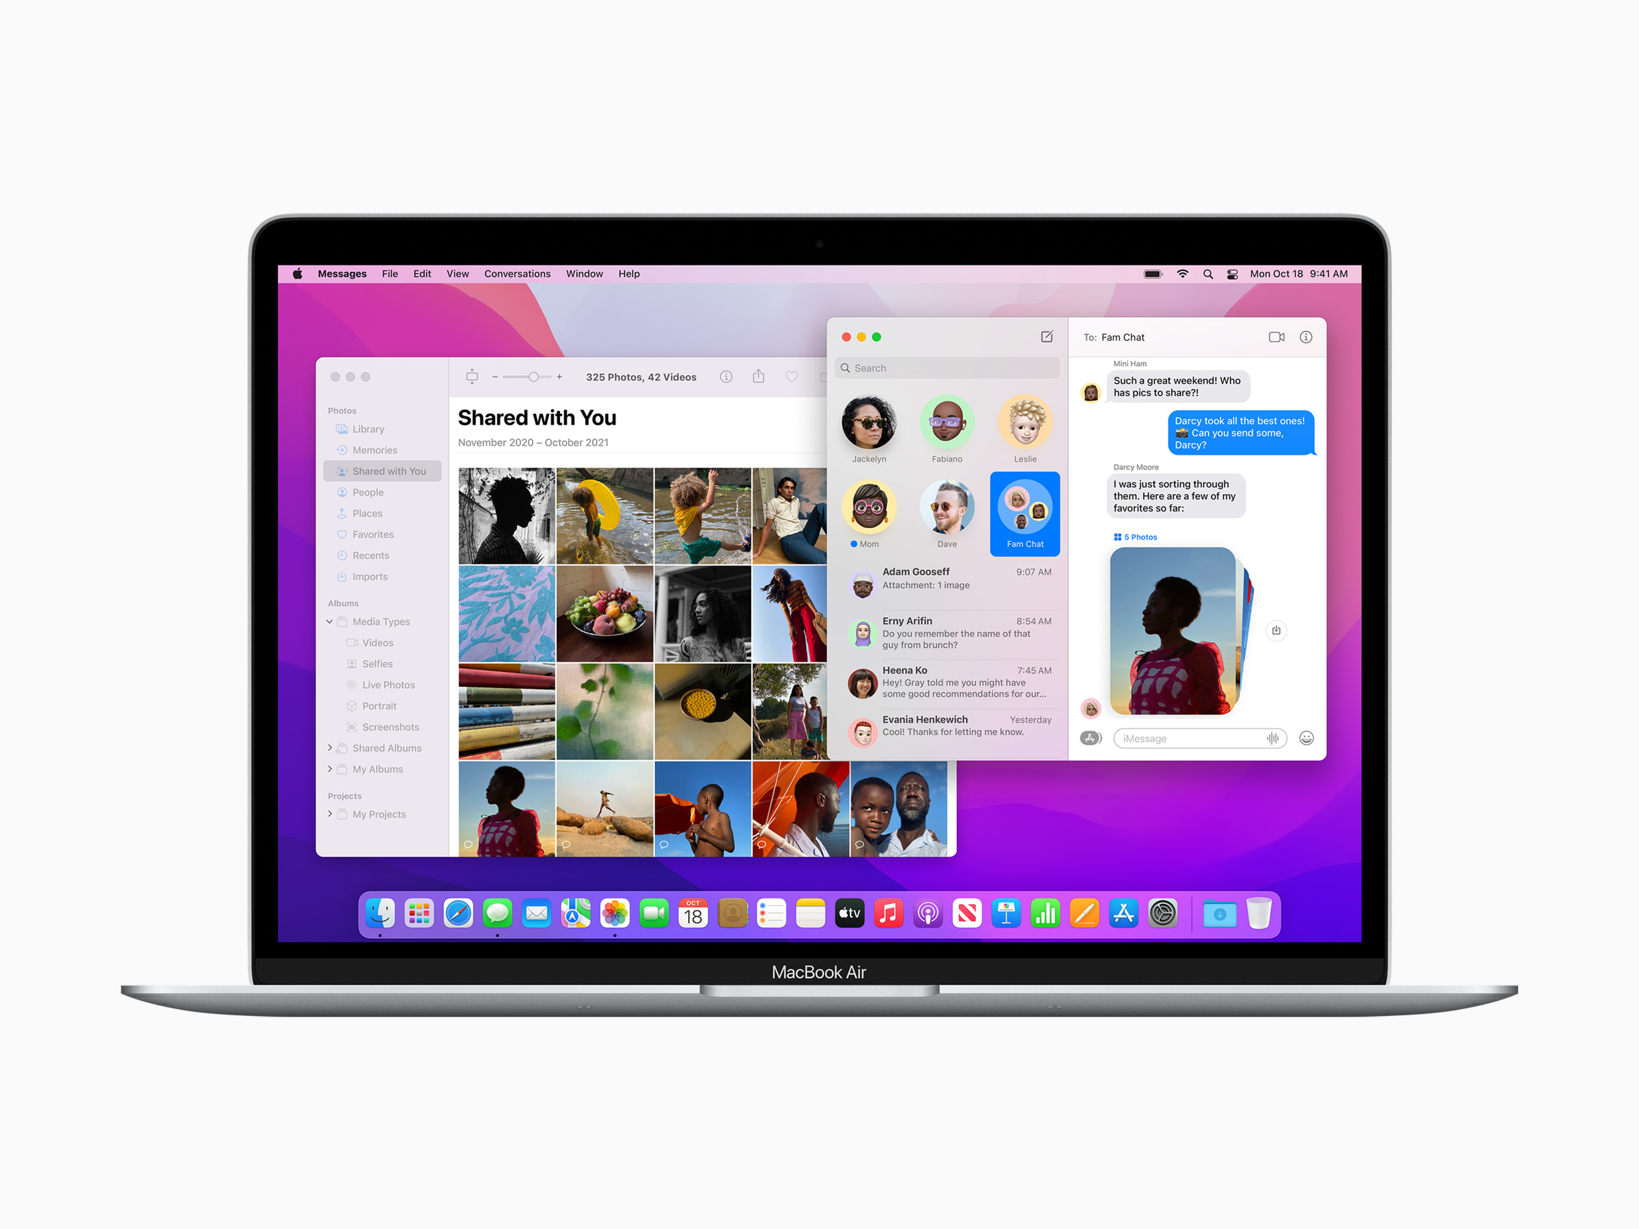
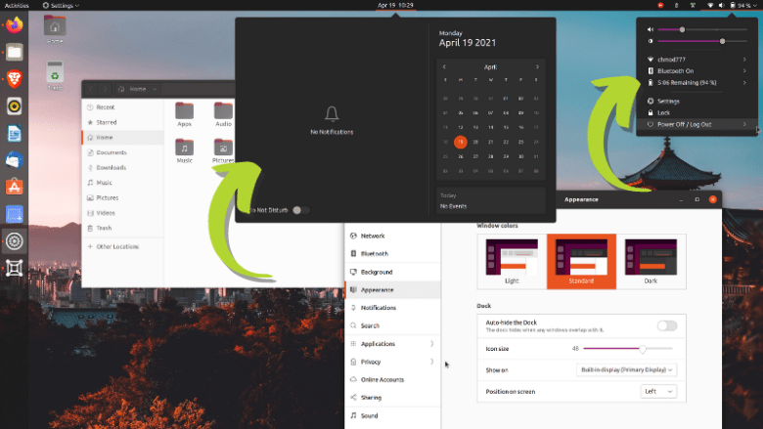
Mostly known / Newest operating systems
Desktop operating systems:
Apple:
macOS 11 Big Sur 2020. November 12.
macOS 12 Monterey 2021. June 7. - Beta
Breaking with the architecture of previous Mac OSes, the tenth system (Mac OS X) was based on Unix and much of the source code was made open source.
Canonical Ltd:
Ubuntu 20.04 LTS Focal Fossa 2020. April 23. support: 2025. April
Ubuntu 21.10 Impish Indri 2021. October 14.
The development code names for each edition are traditionally a pair of adjectives and animal names beginning with the same letter
The word Ubuntu is of African origin, meaning "humanity towards others"; "I am because we are".

Slide 8
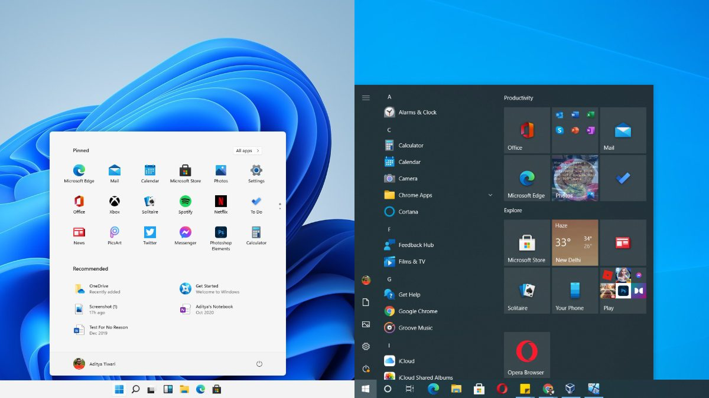
Mostly known / Newest operating systems
Desktop operating systems:
Microsoft:
Windows 10 2015. July 29
Windows 11 2021. October 4
Windows NT kernel
8th generation and newer Intel processors only (with some exceptions),
2nd generation (Zen+) and newer AMD Ryzen processors,
and Qualcomm Snapdragon 850 ARM-based systems. UEFI secure boot and Trusted Platform Module (TPM) 2.0 support is also required. Windows 11 does not support 32-bit x86 systems.
You can also install Android apps on it

Slide 9
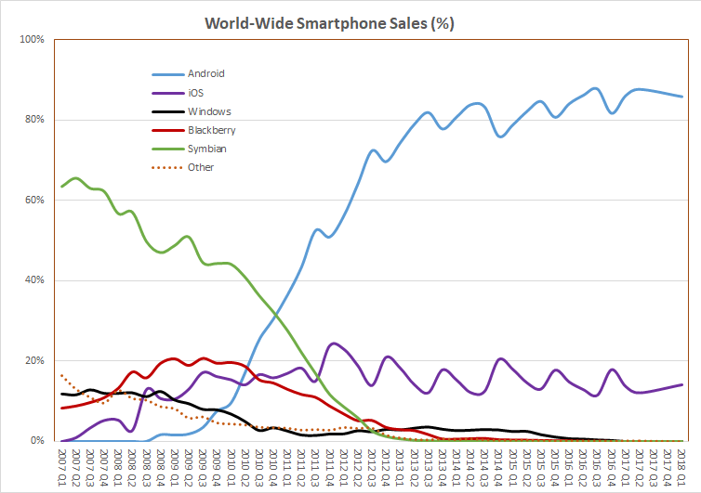
Mostly known / Newest operating systems
Mobil operating systems
They are very similar in operation and architecture to their "desktop" counterparts, such as Windows, OS X or the various Linux distributions that run on desktops, notebooks and laptops, among others. They are mainly focused on wireless connectivity and multimedia, being more consumer electronics than IT devices from the user's point of view, besides being a communication tool.
Google:
Android 12/13
Linux using kernel/Google Play
Apple:
IOS 15.4
Own products/ App Store

Slide 10
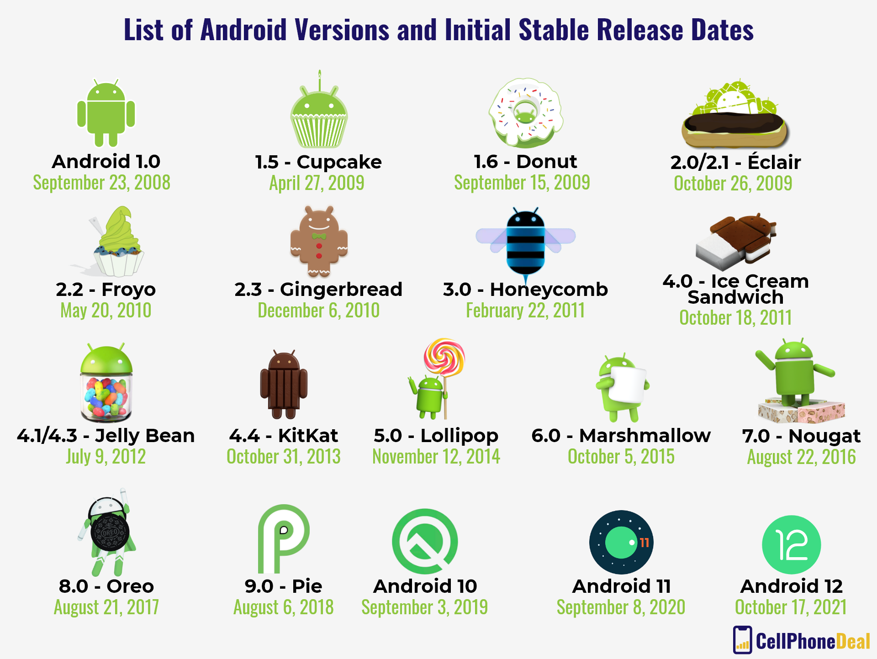
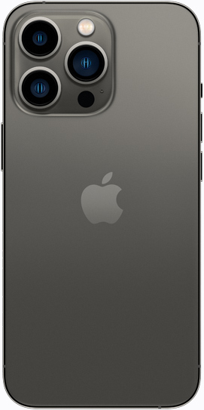
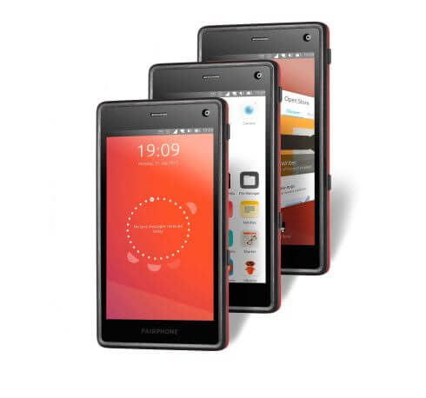
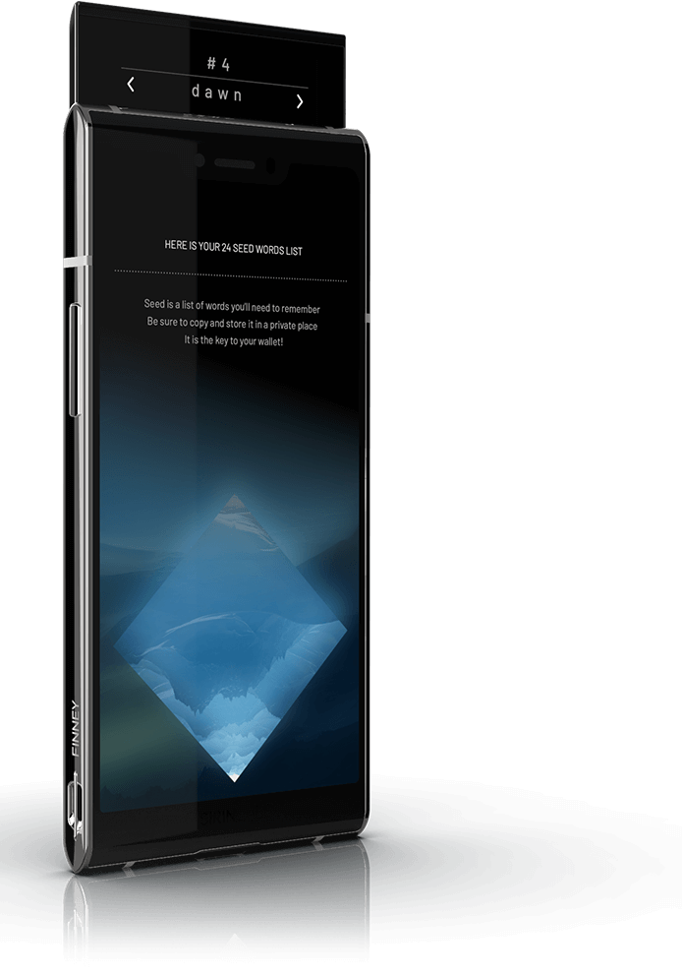
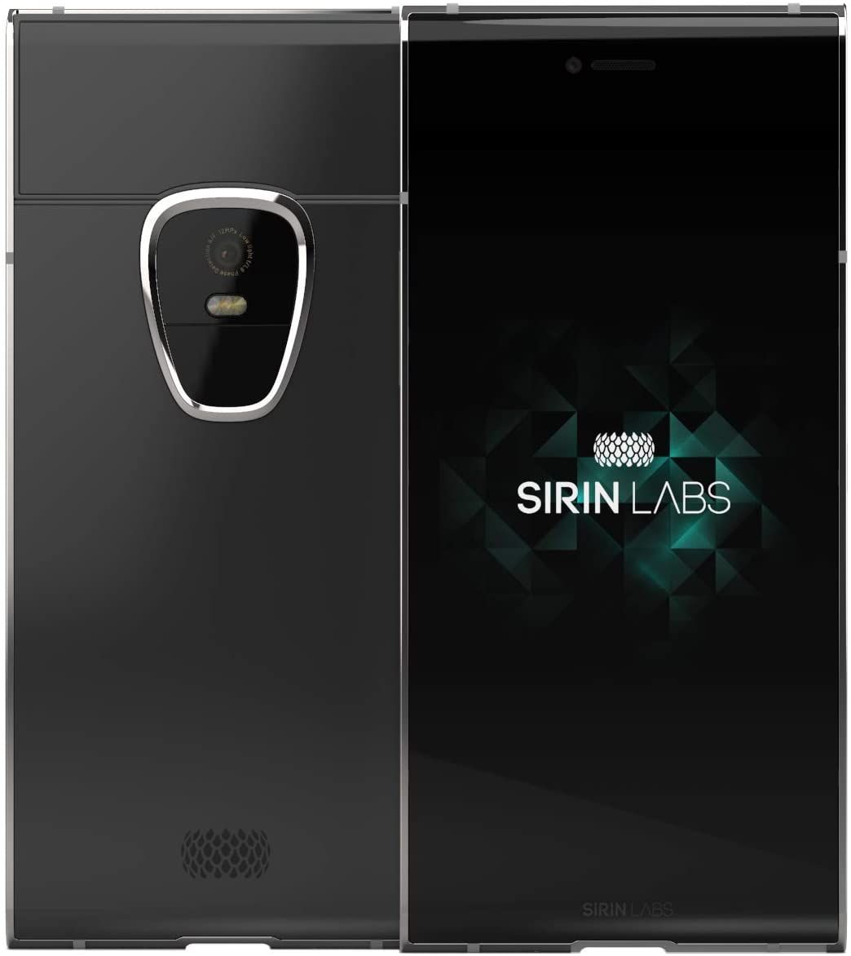
Legismertebb / Legújabb operációs rendszerek
Mobil operációs rendszerek
iPhone 13 pro
IOS 15.4
APP Store
Ubuntu Touch
Ubuntu 16.04
Open-Store.io
https://devices.ubuntu-touch.io/device/
Finney U1
Android
Sirion OS
A SIRIN labs gyártott egy blokklánc okostelefont, a "Finney„-t, amely a SIRIN OS-en működik. Ez az operációs rendszer a blokkláncon alapul, és a legnagyobb biztonsággal működik blokklánc pénztárcaként.

Slide 11
Grouping operating systems

Slide 12
Operációs rendszerek csoportosítás - Felhasználói felület alapján
Text/character user interface
The user types a command on the keyboard and the operating system's text response is displayed on the screen. If a command starts a program, the screen may display the user interface for that program, but when the program is finished, the operating system user interface will reappear. Older operating systems used to use this method, but today's systems that use a graphical user interface also generally provide the option of a so-called command-line mode, where commands can be given in a text interface. The advantage is the simplicity of implementation and the possibility to formulate instructions precisely, but the disadvantage is that it is important to be precise and therefore the commands need to be known exactly in order to be used.
Examples are Unix and Linux systems. In the past (before 1998) the DOS operating system was also used on desktop computers.
Graphical user interface
The operating system kernel (operációs rendszer magja) is surrounded by an external shell (külső burok), through which the user can configure the operating system. From a graphical interface, a keyboard can be used, but the typical input device is the mouse, which is represented on the screen by a pointer, usually in the form of an arrow. Pointing over objects on the screen can be used to give instructions to the operating system by pressing one of the mouse buttons.
The advantage is that it is easier to use, the disadvantage is that the graphical display requires a larger code size and memory usage, so it is slower than the text mode.
Some examples are Windows operating systems, Macintosh operating systems and all Linux distributions.

Slide 13
Grouping operating systems - by the number of users
Single user
The operating system does not allow you to create multiple user profiles.
This was the case with DOS; everyone who used the computer could only use it with the same settings.
Multiple users
It is possible to create your own user profile. This profile can be password-protected and the files and settings of users logging in independently (at different times) are not mixed up.

Slide 14
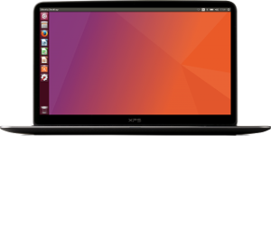
Operációs rendszerek csoportosítás - Forráskód szerint
Open
The program that makes up the operating system, called source code - Open Source - is known to users, so many people can develop modules to make the whole system more complete, or anyone can fix bugs that are discovered. This can make the system more stable faster. The community of developers is spontaneous, and they share their developments with users for free over the Internet. These systems are usually available to users free of charge. An example is the Linux system, which has started to be developed in several directions and has therefore evolved over the years into several distributions. Debian, RedHat, SuSe, Ubuntu, etc.
Closed
The operating system is developed by a company that has a huge apparatus Closed source and spends a lot of money on development, testing, bug fixing and marketing. Such programs have to be paid for. It has to be purchased separately for each computer on which it is installed. This physically means a single medium, and you have to buy as many licenses as you want to install. An example is the Windows operating system from Microsoft.

Slide 15
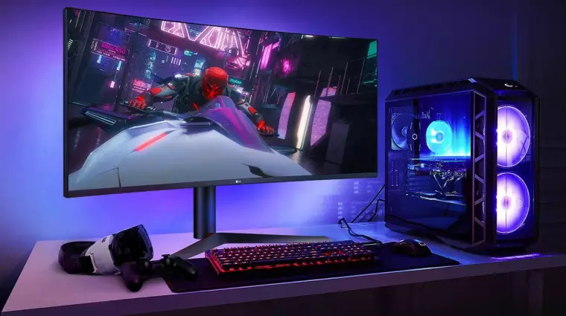
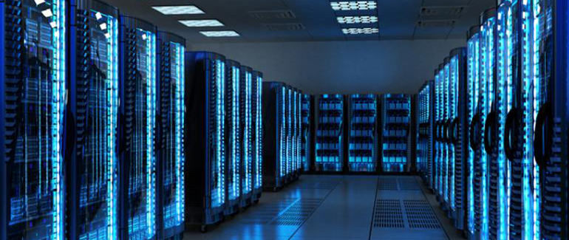
Grouping operating systems -by the method of use
Desktop computers
It typically runs user applications. The operating system is designed to serve user applications in the most optimal way.
Server computers
Network operating systems are based on a server/client architecture, where the server allows multiple clients to share resources.

Slide 16
Operációs rendszerek csoportosítás - További csoportosítások
By hardware dependency
OS for personal, small, large machines, architecture independent
By purpose
General purpose or special purpose
By processors, number of processors
Single or multi tasking, multiprocessing, multi threading
By time allocation
Sequential, cooperative, or intervention; time sharing, real-time

Slide 17
KÖSZÖNJÜK A FIGYELMET!

